Slide 1
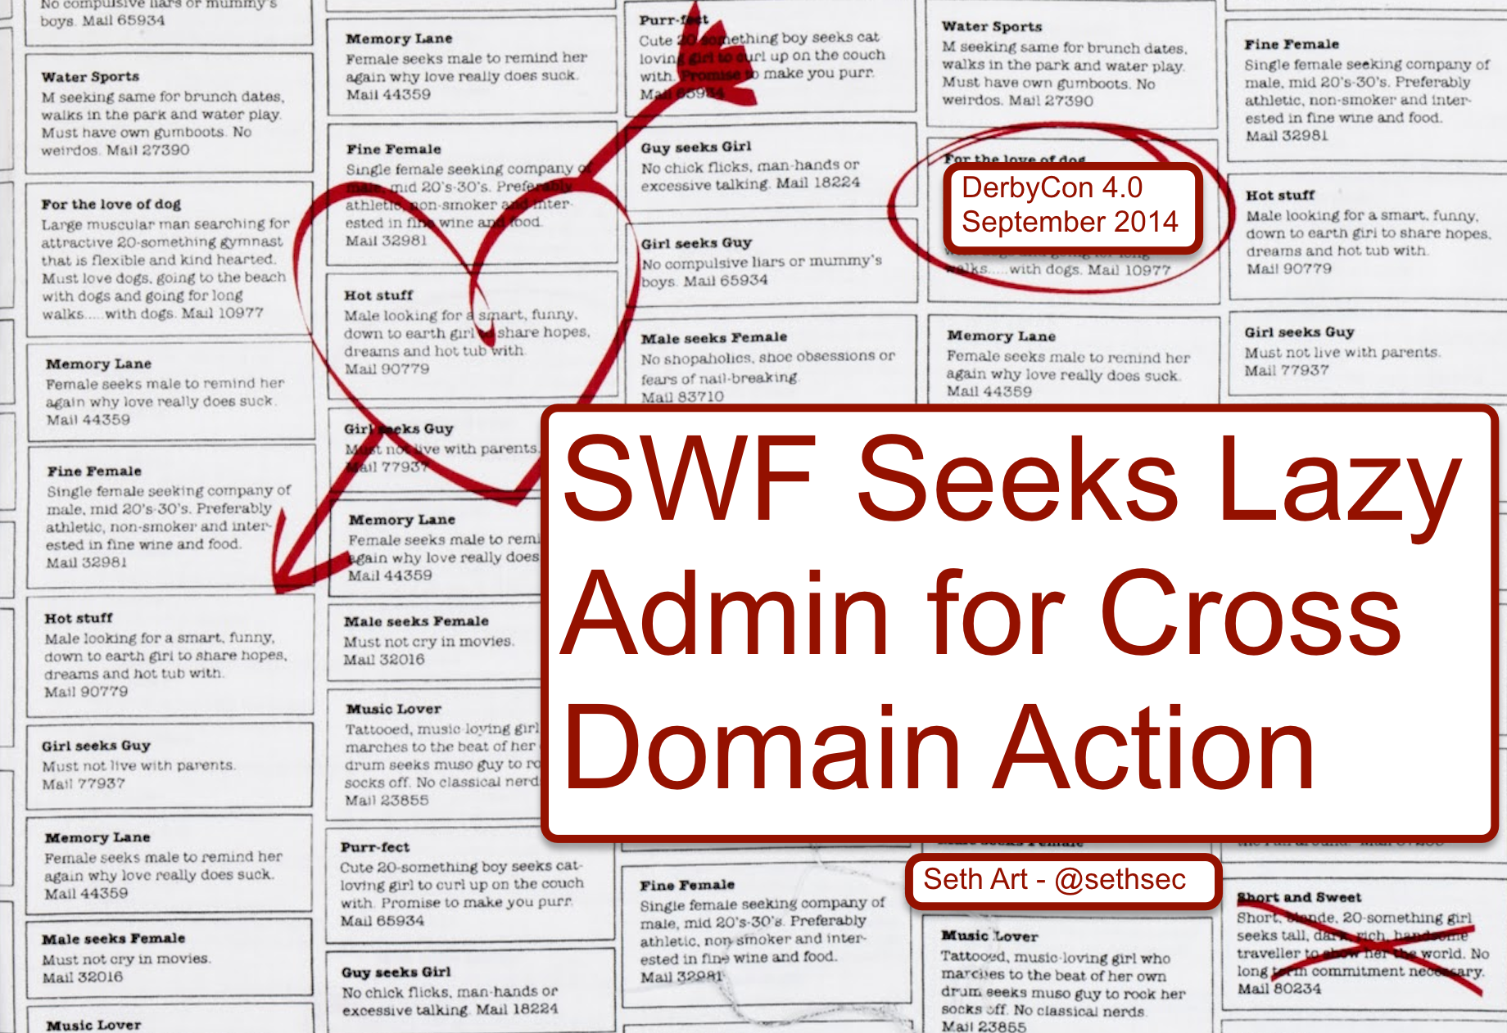

github.com/sethsec
BSidesDC 2014
SWF Seeks Lazy Admin for Cross Domain Action
Notes:
THANKS FOR COMING. My name is Seth Art, and I am going to talk about exploiting crossdomain.xml files
Exploiting CWE-942
(Overly permissive crossdomain.xml files)

Slide 2
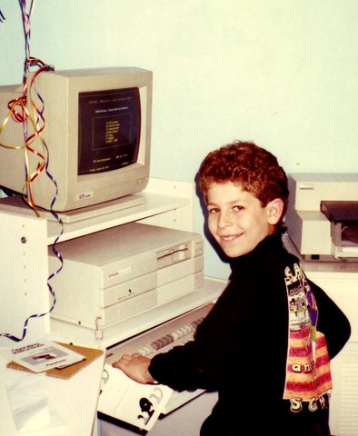
About Me
Notes:
Like most of you, I’ve been playing with computers for as long as I can remember
That right there is my very first computer

Slide 3
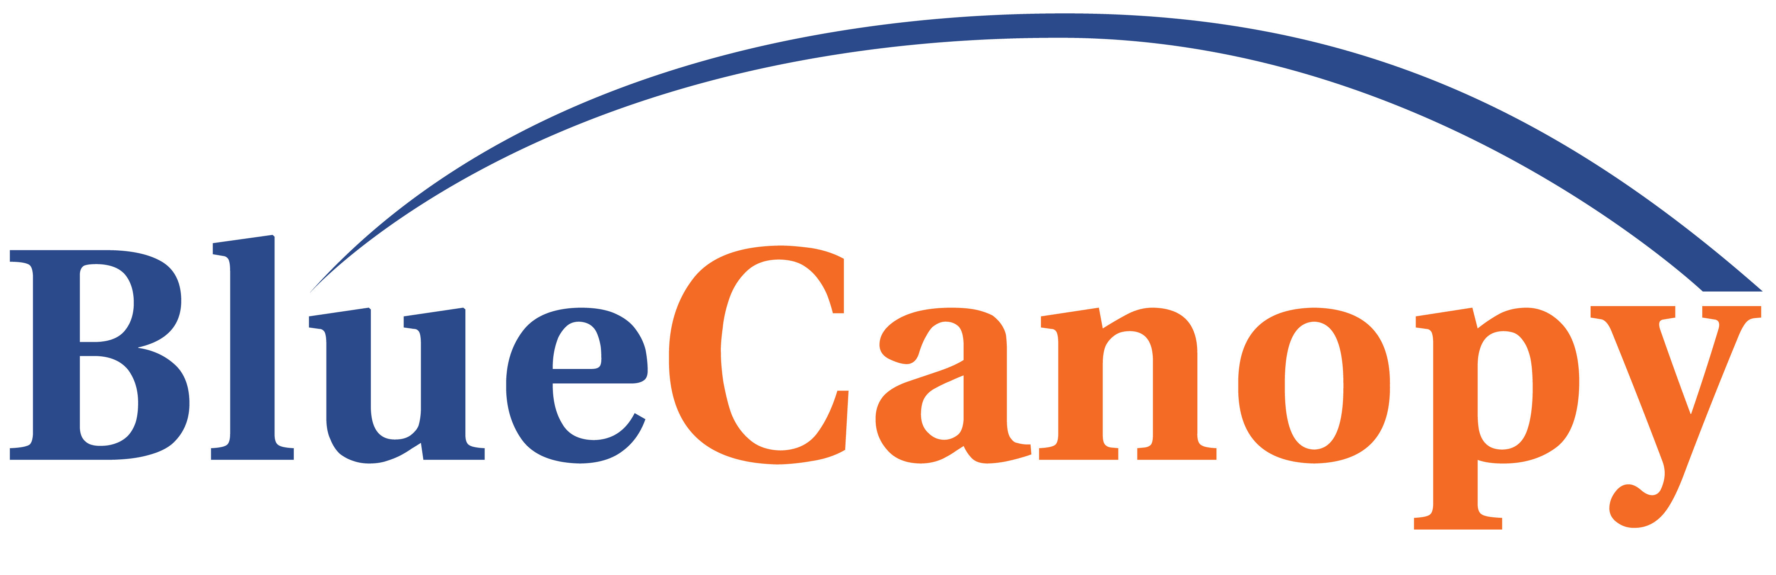
About Me
Associate @
Member: NovaHackers, OWASP DC
Gmail: sethsec@gmail.com | Twitter: @sethsec
Notes:
Currently, I’m an

Slide 4
Outline
What is the crossdomain.xml file?
Vulnerability intro
Where is the vulnerability?
How can it be exploited?
How can I exploit this myself?
Notes:
The purpose of this talk… Introduce you to crossdomain.xml
convince you to start looking for the crossdomain.xml file on every web application you test, and to… Show you how to create working exploits.

Slide 5
Same Origin Policy
“The same-origin policy restricts how a document or script loaded from one origin can interact with a resource from another origin.”
https://developer.mozilla.org/en-US/docs/Web/Security/Same-origin_policy
SOP is enforced at the browser
Notes:
I’m sure most of you are familiar with SOP, but I wanted to cover it very quickly anyway.
One browser, two tabs

Slide 6
What is the crossdomain.xml file?
If a SWF is embedded at siteA.com and tries to load data (XML, RSS, HTML, etc) from siteB.com the Flash Player will disallow the request (by default).
– modified, but taken from crossdomainmaker.com
Notes:
let me explain it this way
SWF aka Flash Object

Slide 7
What is the crossdomain.xml file?
If a SWF is embedded at siteA.com and tries to load data (XML, RSS, HTML, etc) from siteB.com the Flash Player will disallow the request (by default).
siteB.com can grant siteA.com access to its data through a cross domain policy file.
– modified, but taken from crossdomainmaker.com
Notes:
However, with flash…
This is essentially creating a white list of trusted domains

Slide 8
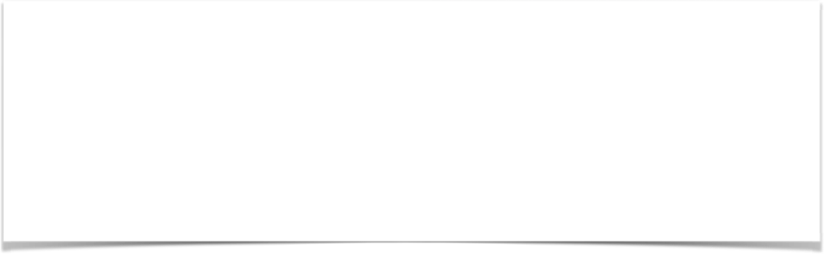
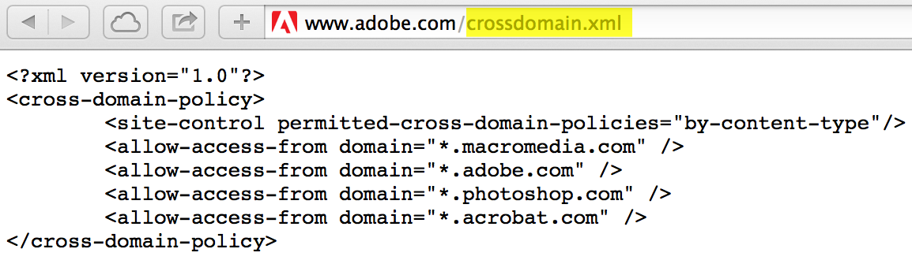
GOOD
Notes:
This is good crossdomain.xml. So lets start at square one. This is a properly configured crossdomain.xml file.
This means that the only SWFs loaded from one of those four domains, has the ability to interact with www.adobe.com.

Slide 9
GOOD
Notes:
This is good crossdomain.xml. So lets start at square one. This is a properly configured crossdomain.xml file.
This means that the only SWFs loaded from one of those four domains, has the ability to interact with www.adobe.com.

Slide 10
GOOD

Slide 11
GOOD

Slide 12
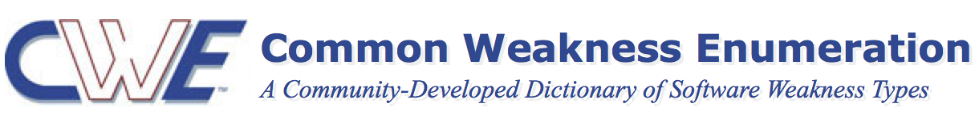
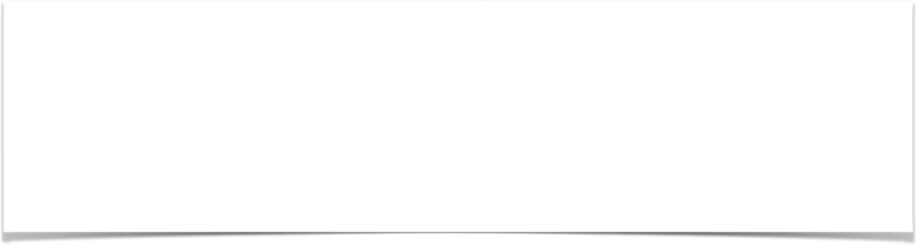
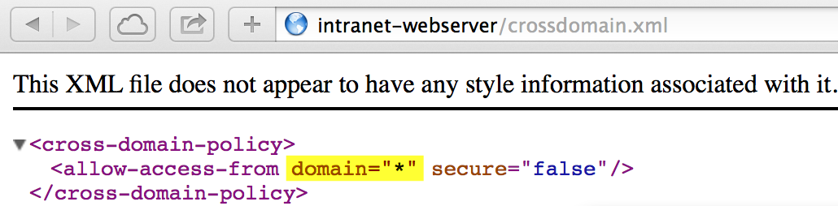
*This configuration is not always bad, but we will get into that later
Notes:
This is a bad crossdomain.xml file.
When we say overly permissive cross domain policy file, this is what we are talking about.
Particularlly, this combination - domain = *

Slide 13
Vulnerability Intro
Think of exploitation as a mix of CSRF and XSS
CSRF - You are getting the victim to execute your forged requests
XSS - Unlike normal CSRF, you can not only make the request, but you can read the data that comes back
Server side vulnerability, client side exploitation
Notes:
For those of you already familiar with AppSec
To illustrate this last point, let me show you some graphics

Slide 14
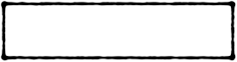

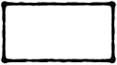
Vulnerability Intro
vulnerable.com
malicious.com
Evil SWF
Victim
Notes:
These are the players.

Slide 15
Vulnerability Intro
vulnerable.com
malicious.com
Evil SWF
Victim
Notes:
Like CSRF and XSS, the malicious server never sends a sing request to the vulnerable server. I used to get stuck on this point

Slide 16
Vulnerability Intro
vulnerable.com
malicious.com
Evil SWF
Victim
Notes:
Requirement 1: Victim needs to be authenticated with the vulnerable server

Slide 17
Vulnerability Intro
vulnerable.com
malicious.com
Evil SWF
Victim
Notes:
Requirement 2: The attack requires the victim to arrive at the malicious host (phishing, watering hole, etc)

Slide 18
Vulnerability Intro
vulnerable.com
malicious.com
Evil SWF
Victim
Evil SWF
Notes:
Red line shows the victim loading the SWF in browser

Slide 19
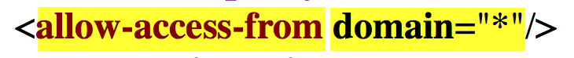
Vulnerability Intro
vulnerable.com
malicious.com
Evil SWF
“Hey Crossdomain.xml, do I have permission to talk to you?”
Victim
Evil SWF
Notes:
Flash player asks…

Slide 20
Vulnerability Intro
vulnerable.com
malicious.com
Evil SWF
Victim
“Yes! Yes, you do!”
Evil SWF
Notes:
Server says:

Slide 21
Vulnerability Intro
vulnerable.com
malicious.com
Evil SWF
“Time to steal anything the victim can access.”
Victim
Evil SWF
Notes:
Evil SWF says

Slide 22

Vulnerability Intro
vulnerable.com
malicious.com
Evil SWF
Victim
“Here you go!”
Evil SWF
Notes:
Gold because the SWF just got the server to cough up some sensitive data!

Slide 23

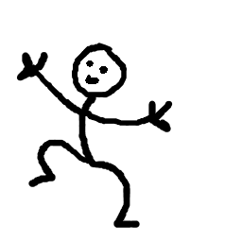
Vulnerability Intro
vulnerable.com
malicious.com
Evil SWF
Victim
Exfiltration!
Evil SWF
Notes:
Happy dance (graphic?)

Slide 24
Determining Risk
vulnerable.com
Still vulnerable even if no applications on the server use Flash
Notes:
Lets talk a little more about this vulnerable server

Slide 25
Determining Risk
vulnerable.com
Still vulnerable even if no applications on the server use Flash
All applications on this FQDN are vulnerable
Notes:
12 apps all on the same intranet-webserver. 1 app team uploads crossdomain.xml to the root —> all 12 apps are vulnerable!!

Slide 26
Determining Risk
vulnerable.com
Is there anything worth stealing?
Are there actions worth CSRFing?
If not, there is no risk!
Notes:
The other thing you need to evaluate is whether or not there is anything worth stealing or csrfing. If you have an overly permissive crossdomain.xml file on a brochure site that only contains public information, there is no risk

Slide 27
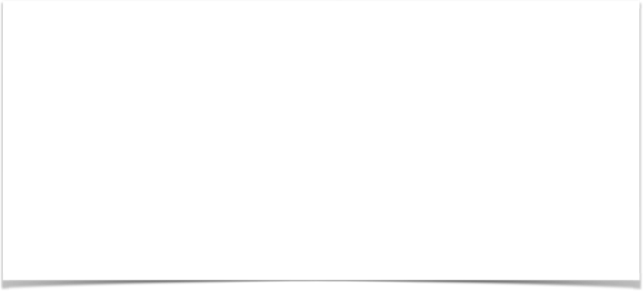
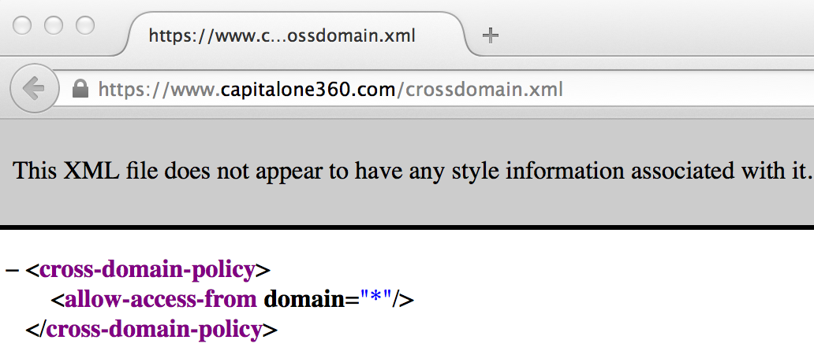
Determining Risk
Notes:
Here is good example of that.

Slide 28
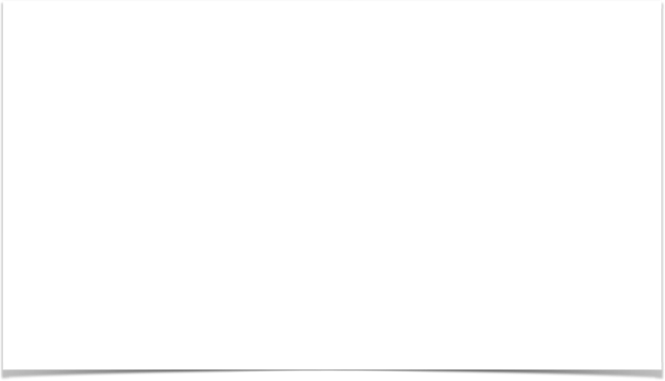
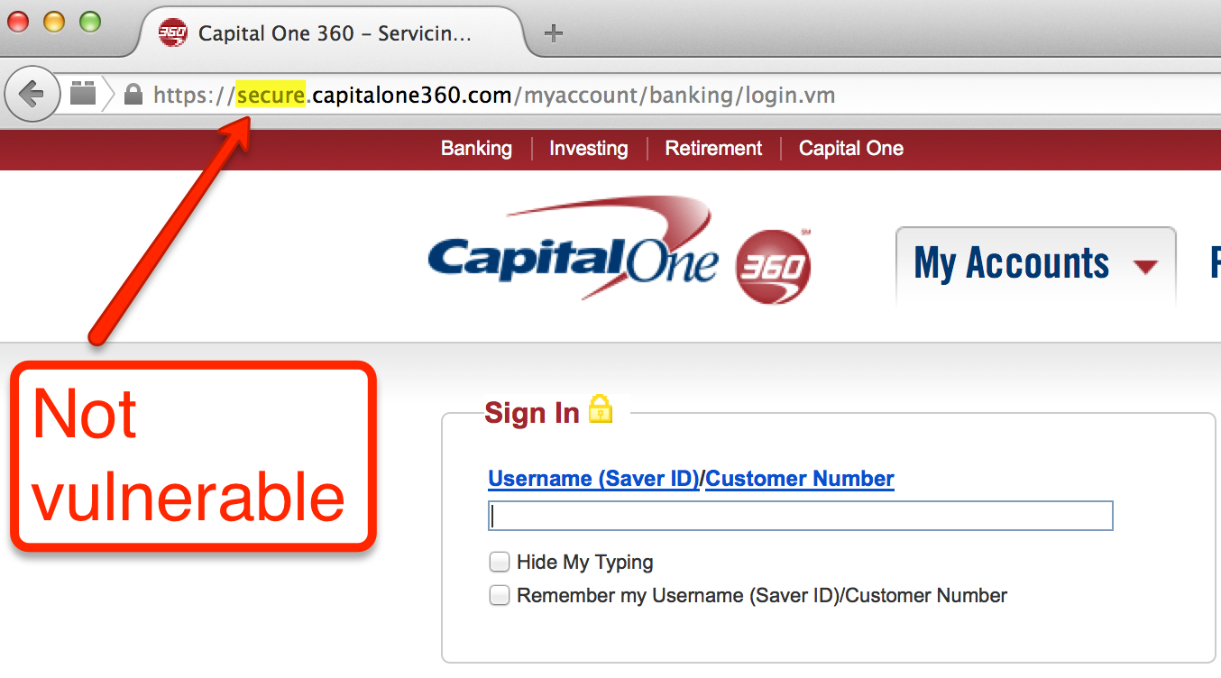
Determining Risk

Slide 29
Discovery
Notes:
So now that we know a little about the vulnerability, let me show you how to find it.
The first way is fairly obvious. Just append crossdomain.xml to every domain you visit, and keep your eyes open for domain=“*”.

Slide 30
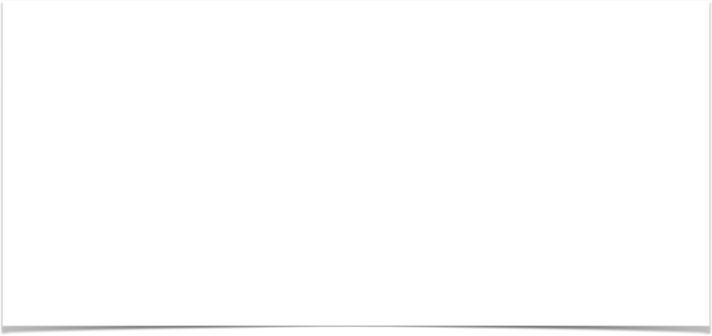
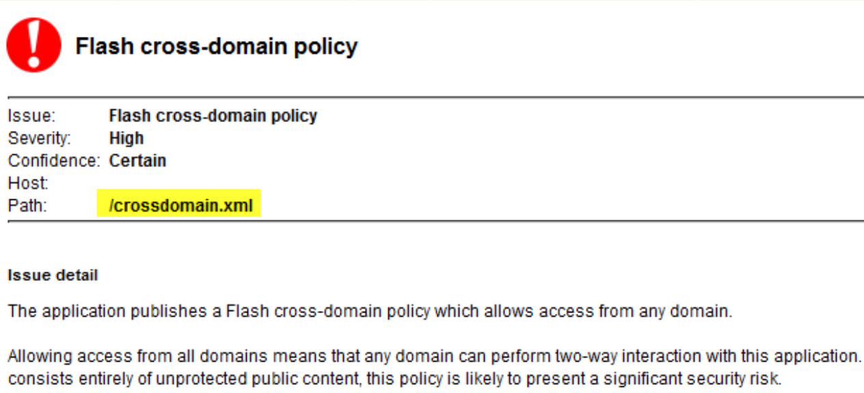
Discovery
Notes:
It’s also nice to have a tool like Burp Suite Pro, which, if you have the active scanner enabled, enabled, it will do that check for you and alert you when it sees domain=*

Slide 31

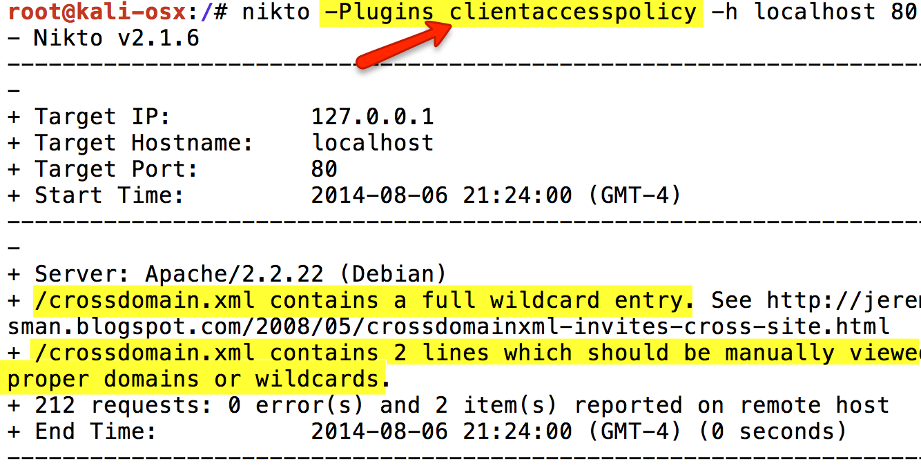
Discovery

Slide 32
History

Slide 33
History
This is an old vulnerability!
2003: Flash player 7 introduced crossdomain.xml
2006: Chris Shiflett, Julien Couvreur, and Jeremiah Grossman started talking about this publicly
2010: Erland Oftedel released MalaRIA-proxy
Notes:
So you might ask yourself, WHY AM I LISTENING TO A TALK about at a security conference in 2014.

Slide 34
Not much traction
Here are some Google search results, as of March 2014:
Search Term | Results
“crossdomain.xml exploit” | 34 unique hits
“crossdomain.xml attack” | 26 unique hits
“crossdomain.xml vulnerability” | 18 unique hits
Notes:
This is why. Even though There is information about the vulnerability, and even POC tools available, there are public examples of exploitation out there. The vuln is always talked about in theoretical terms.

Slide 35
Exploitation
How to do I create a proof of concept (POC) exploit?
Notes:
Obviously something changed, because we are here…

Slide 36
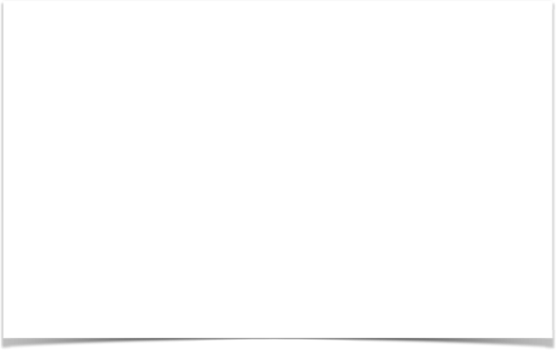

Enter Gursev Kalra
http://gursevkalra.blogspot.com/2013/08/bypassing-same-origin-policy-with-flash.html
Notes:
For me, exploitation became possible when I found this blog post by Gursev Kalra.

Slide 37
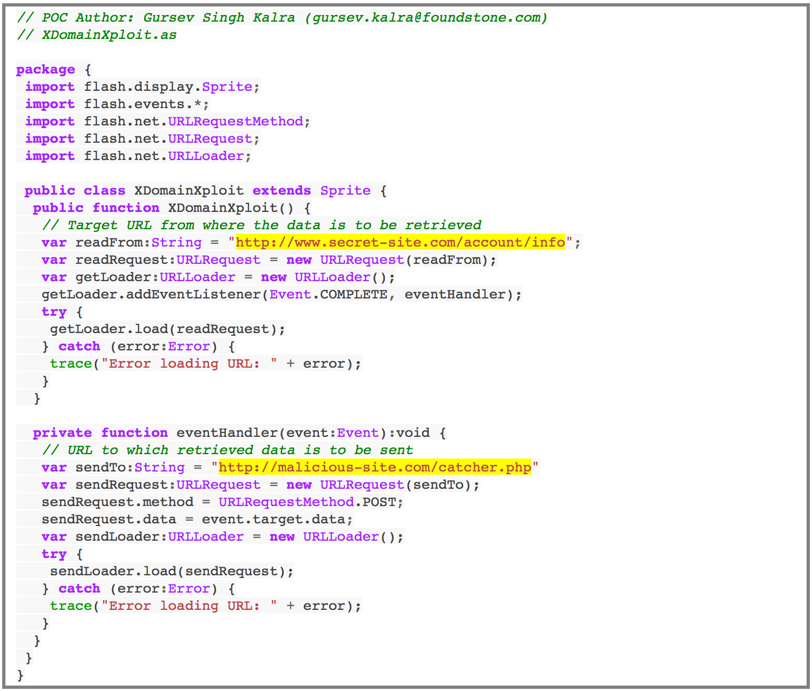
Notes:
Along with his blog post, Gursev released this POC code, (which is one single file) and some background info on his blog post, and i was finally able to wrap my head around the vuln and put all the pieces together

Slide 38
So then I thought… what about the internet?
Notes:
SO i finally had the ability to write an exploit, but I didn't have a vulnerable application at work to test on. So i figured the internet should have something for me.

Slide 39
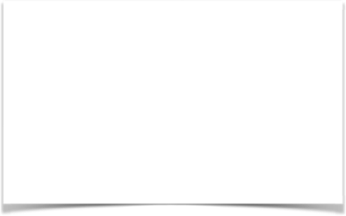
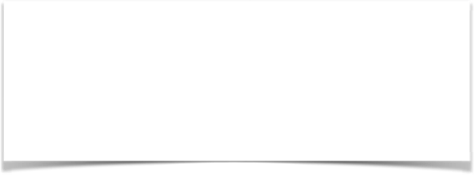
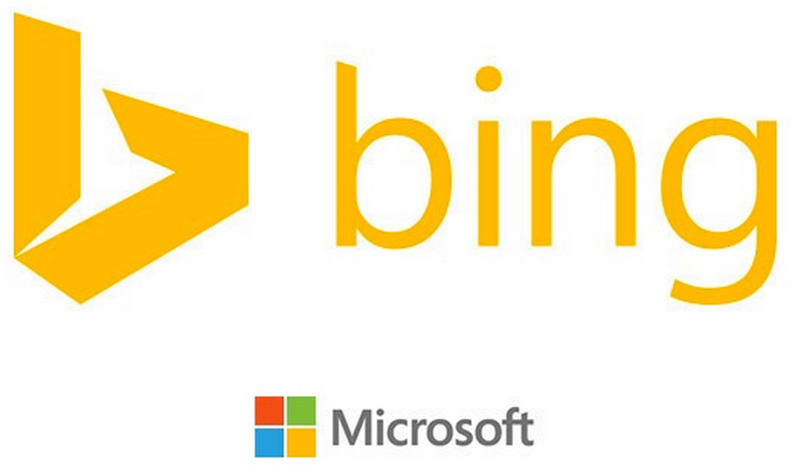



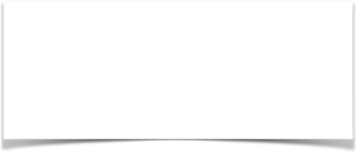

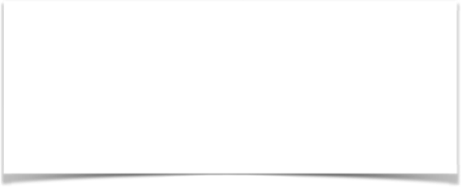

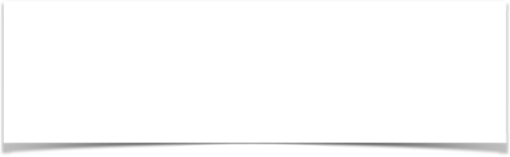
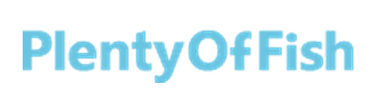
So then I thought… what about the internet?
Notes:
And I was not dissapointed. These are some of the sites that I responsibility disclosed this vuln to …
** And trust me, there are plenty more out there. **

Slide 40
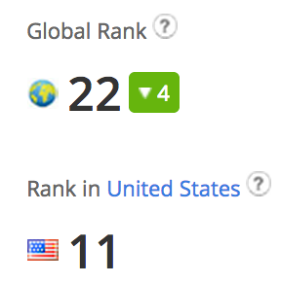
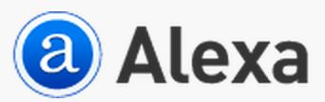
Stealing Sensitive Data
Notes:
Lets jump into the first example.

Slide 41
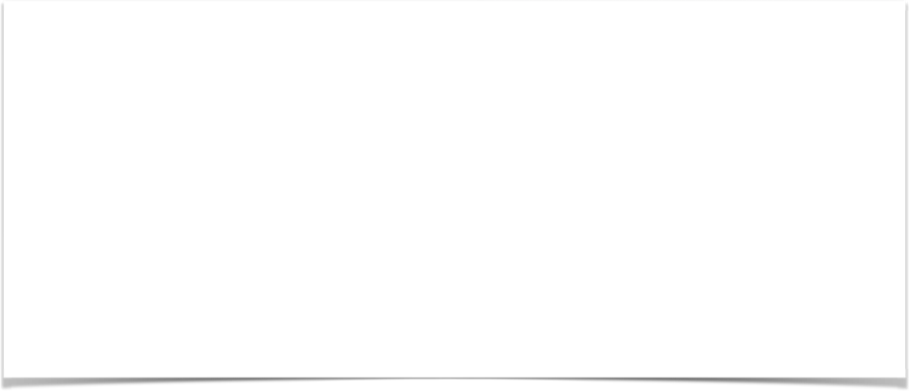
Stealing Sensitive Data
1) Overly permissive crossdomain.xml file
Notes:
Lets jump into the first example.

Slide 42
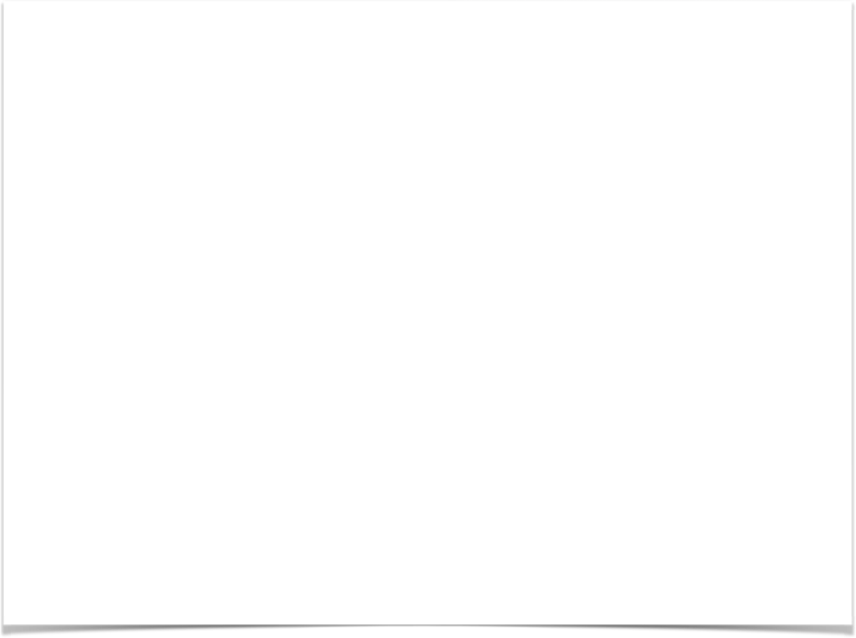
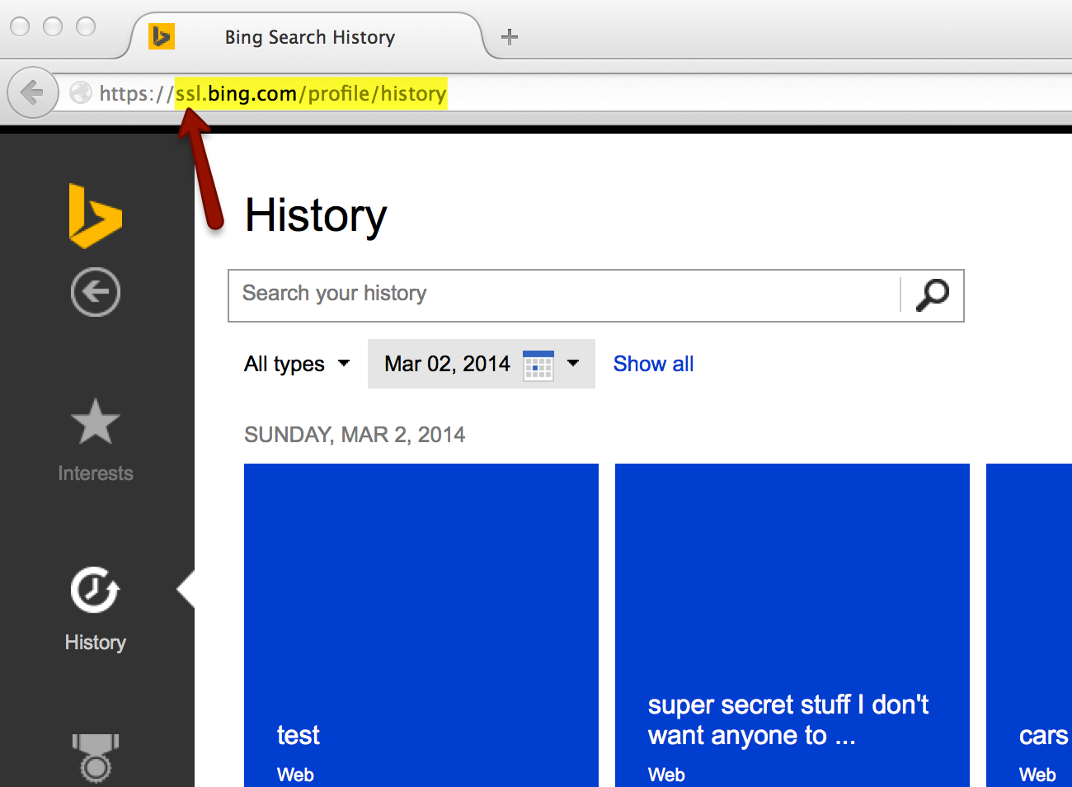

Slide 43

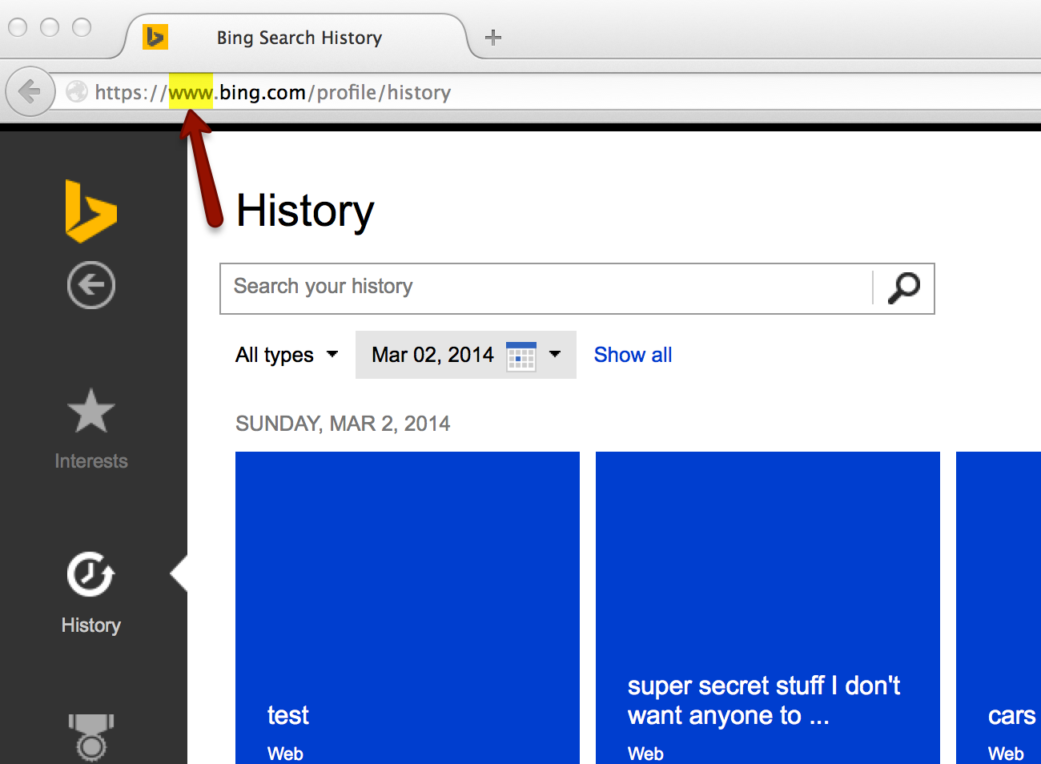

Slide 44

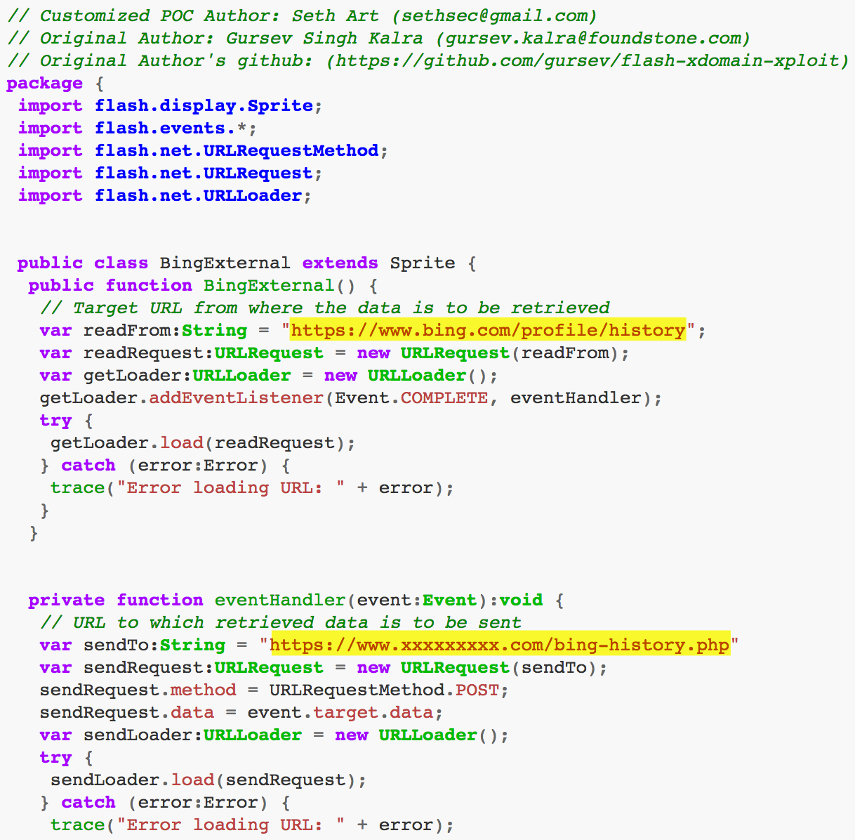
Notes:
basically gursevs POC. only thing modified is in yellow
Remember, this gets compiled into a SWF, and these actions are performed by the user who has loaded the SWF.

Slide 45
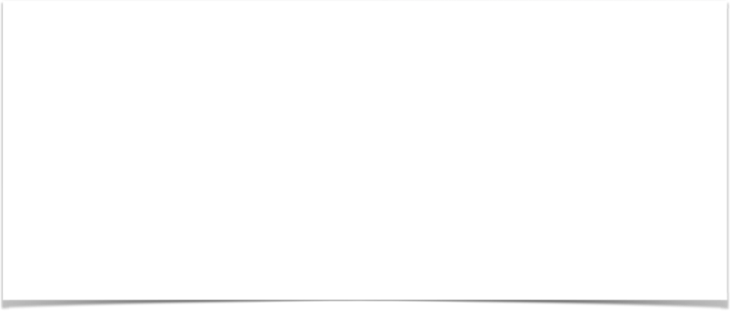
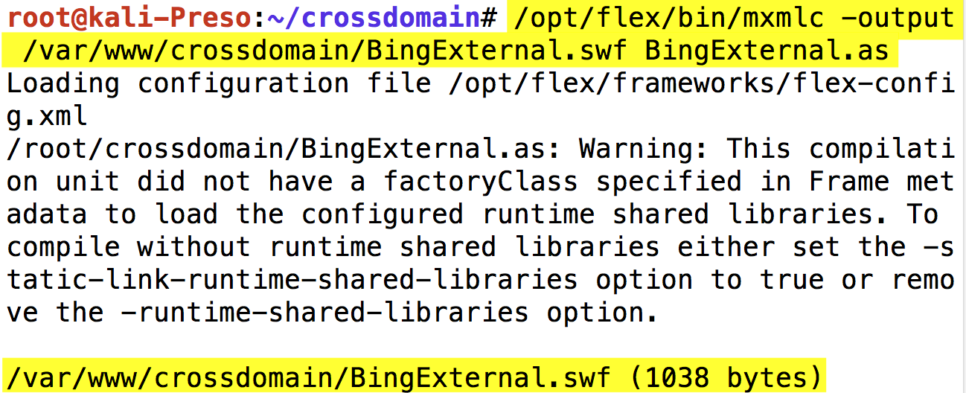

Slide 46
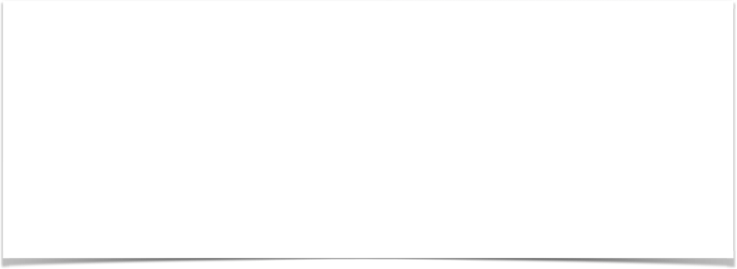
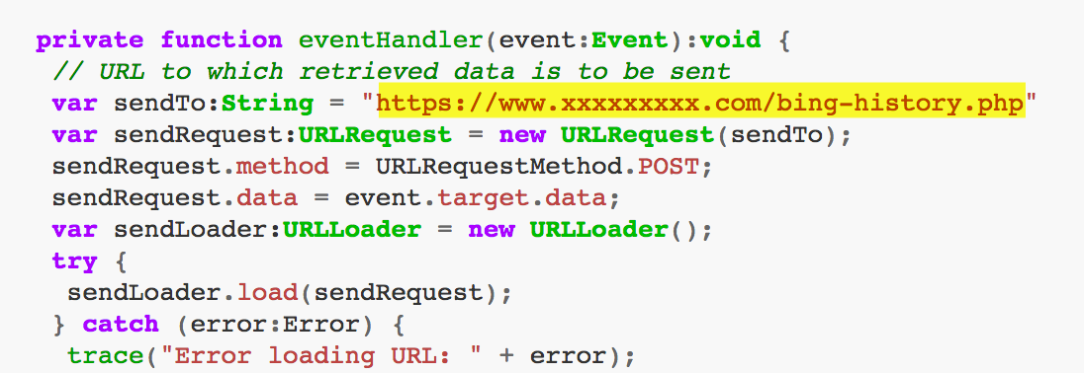

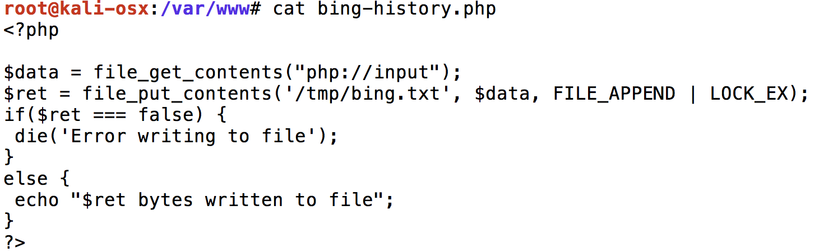

Slide 47
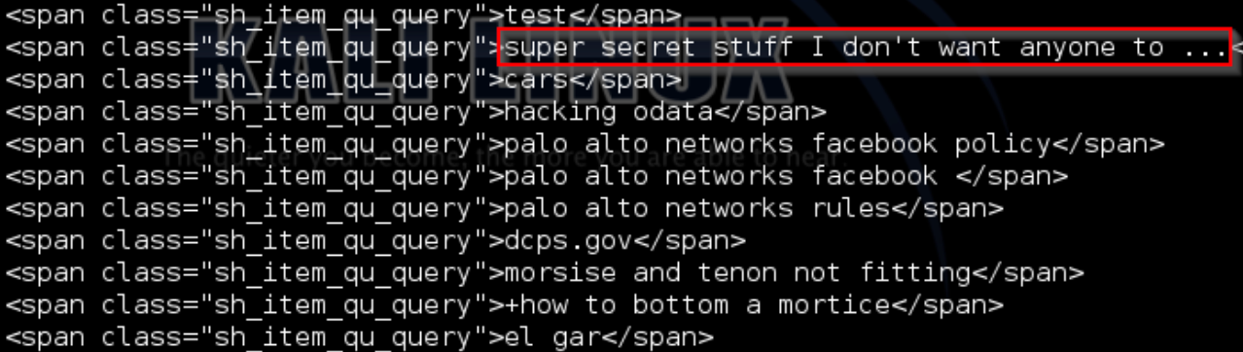
root@kali:/# cat /tmp/bing.txt | xmllint --format - | grep "sh_item_cl_url"
Notes:
happy dance

Slide 48
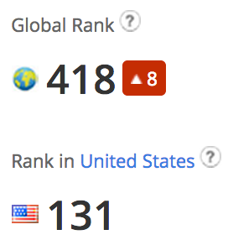
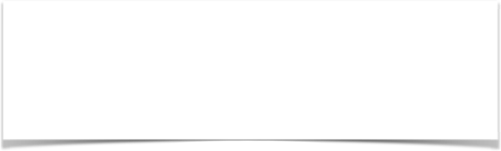
Stealing Sessions
Notes:
a little story. I tried the contact form, the security@ and support@ email address, but no luck. No good leads on linked in (based in Vancouver). So i filled out a job application

Slide 49
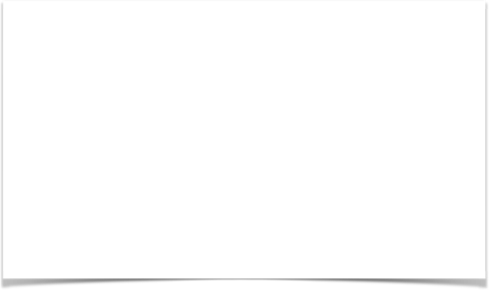
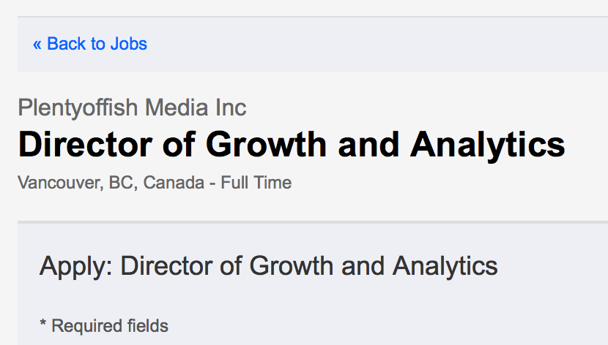
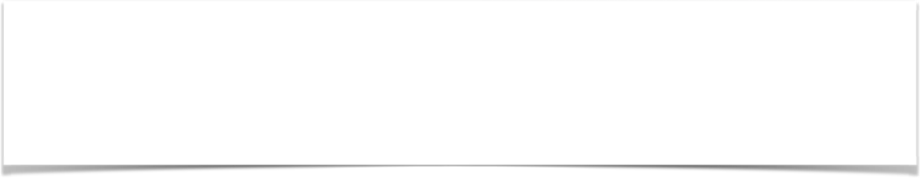
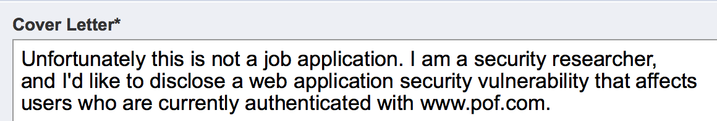
Stealing Sessions
Notes:
Applied to most important sounding job and told them it have been trying to get in touch with someone…
A day later, got an email from Marcus Frind, the CEO

Slide 50
Stealing Sessions
1) Overly permissive crossdomain.xml
2) Session cookie(s) in HTML Body
Notes:
Back on topic: This example allows me to talk about a limitation of exploitation crossdomain.xml

Slide 51
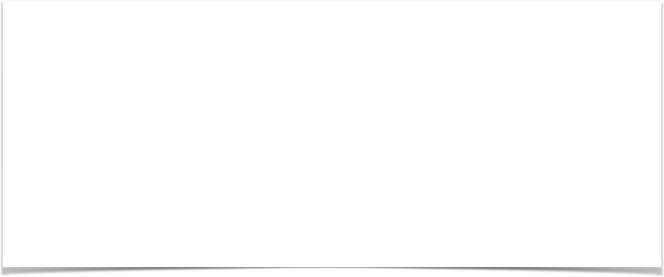
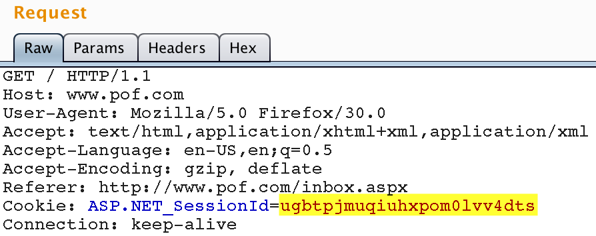

Slide 52

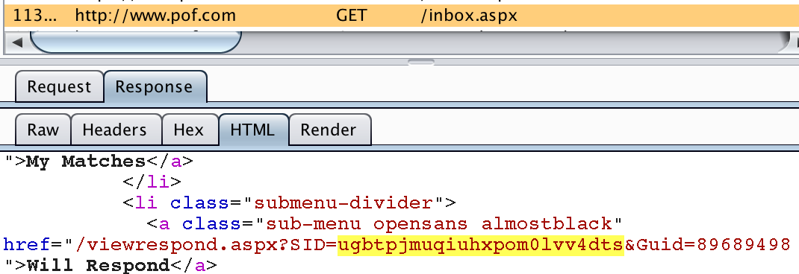

Slide 54


Slide 55

Bypass CSRF defense (Nonces)
Notes:
One more quick story about imgur first.

Slide 56


Bypass CSRF defense (Nonces)
Notes:
11:29pm, 11:31pm, 12:15am fixed

Slide 57
Bypass CSRF defense (Nonces)
1) Overly permissive crossdomain.xml file
2) What if they protect against CSRF using Nonces?
Notes:
Nonces are unique values that the server provides the the clients in a hidden form field, that an attacker can not guess ahead of time
As a result, the attacker can not forge the form
In PREVIOUS EXAMPLES, we made 1 request to vulnerable.com and one to malicious.com. In THIS example, we are going to make two requests to vulnerable.com

Slide 58


Bypass CSRF defense (Nonces)
Notes:
Back to websites
Let’s combine the READ examples with the CSRF examples
If I just hit the submit button…

Slide 59


Bypass CSRF defense (Nonces)
Notes:
This is what a valid request looks like That is the nonce, the hidden value that the attacker has no way of knowing.

Slide 60


Notes:
SWF needs to do four things

Slide 61
Notes:
SWF needs to do four things
1) Make initial request to the page that gives the victim the nonce

Slide 62
Notes:
2) Pull nonce out of html source

Slide 63


Notes:
3) Recreate that string that you see up there

Slide 64

Notes:
4) Send the forged request back to the vulnerable web server

Slide 65


Slide 66


What else can you do?

Slide 67
What else can you do?
If the “Change Email” function does not require current password, you can change the victims email address (CSRF) and hijack their account with the forgot password feature

Slide 68
What else can you do?
If the “Change Email” function does not require current password, you can change the victims email address (CSRF) and hijack their account with the forgot password feature
If the application obscures file downloads by randomizing download links, and does not check for authentication, you can steal those download links

Slide 69

Hijacking Accounts

Slide 70
Hijacking Accounts
1) Overly permissive crossdomain.xml
2) Email change does not require current password

Slide 71



Hijacking Accounts
Notes:
Verification = Great

Slide 72


Hijacking Accounts
Notes:
NO Verification = BAD

Slide 73


Hijacking Accounts

Slide 74



Slide 75



Slide 76


Hijacking Accounts
Notes:
and now i can enter any password i want and i have access to their account

Slide 77


My Last Trick
Notes:
This is just a portion of the crossdomain.xml file at security.history.com
89 whitelisted domains

Slide 78


My Last Trick
Guess who owns seenonstyle.com?
Notes:
In fact, this domain exists in at least 4 crossdomain.xml files that I have downloaded.
I have one example of a domain that

Slide 79

My Last Trick

Slide 80

http-crossdomain.nse

Slide 81
http-crossdomain.nse

Slide 82
http-crossdomain.nse

Slide 83



Slide 84



Slide 85


Notes:
Mention that the reason I don’t have the thing 100% automated is that I could not find a bulk search lookup API that did not require an API key.

Slide 86

How can I make my own exploits
SWF-Server is an installer and web server:
Download and extract Adobe Flex (SWF Compiler)
Provide you with ActionScript templates
Create a self-signed SSL cert
Tell you how to compile your ActionScript files
Install NMAP script
Serve your exploits

Slide 87



Demo
CVE-2014-2225 - CSRF
CVE-2014-2227 - Crossdomain.xml

Slide 88
Recommendations
Be careful who you trust (in your crossdomain.xml)
Periodically review the list of trusted third parties
Notes:
First: Properly restrict your crossdomain.xml if you use one.

Slide 89
Recommendations
Segment your data by subdomain
www.site.com -> Non-sensitive data
login.site.com -> Authentication
data.site.com -> Sensitive data
Notes:
First: Properly restrict your crossdomain.xml if you use one.

Slide 90
Defense in Depth Recommendations
Require user to enter password for ANY sensitive action related to account settings
Change password
Change email
Change address

Slide 91
Defense in Depth Recommendations
Never return back Credit Card numbers, SSNs, etc
If the user wants to change the info, ask for it again

Slide 92
Defense in Depth Recommendations
Implement Referer header checking when/if possible
Whitelist trusted domains

Slide 93
Prior Work
2006
2010 2011
2013
Chris Shiflett: Dangers of cross domain..., Crossdomain.xml Witch Hunt Julien Couvreur: Crossdomain.xml security warning Jeremiah Grossman:Crossdomain.xml statistics
Erlend Ofedel: Why you need to lock down your..., Created MalaRIA-Proxy Mike Bailey: New, Neat, and Ridiculous Flash Hacks FORTH-ICS: An Empirical Study on the Security of Cross-Domain Policies… SAP Research: Client-Side Cross-Domain Requests..., The State of the Cross-domain Nation UC San Diego: Analyzing the Crossdomain Policies of Flash Applications
Gursev Kalra: Same Origin Policy Bypass with Flash

Slide 94
Questions?

Slide 95

Thank you!
Blog: http://sethsec.blogspot.com
Github: https://github.com/sethsec/ (I’ll post these slides)
Gmail: sethsec@gmail.com | Twitter: @sethsec
Notes:
I’m going to post this deck to github as well

